Slide 1
UNIT-5
Random Access Memory
By
M.K. Srilekha
Assistant Professor, ECE, SRMIST, KTR

Slide 2
Memory
Memory unit – Collection of cells capable of storing large amount of binary information.
Binary information is stored.
The information is needed for processing
The associated circuits needed to transfer the binary information in and out of the device.
Write operation- To store the information in the memory.
Read operation- To transfer the stored information out of the memory.

Slide 3
Memory devices
Two type
Random access memory-Read Write memory
Accept the new information for storage to be available for later use.
Read only memory
Performs only read operation.

Slide 4
Random Access memory
A memory unit that stores group of bits
1 byte-8 bits
1 word- 16 bit
Interface
n data input and output line
K address selection line
Control lines indicating direction of transfer.

Slide 5
Random Access memory
Addressing
Each word is assigned to address.
K bit address- 0- 2^{k} -1 word.
Size Kilo 2¹⁰, Mega 2²⁰, Giga 2³⁰
A decoder accepts an address and is
used to select specified word.
n Data Input Lines
n
k Address Lines
Memory
k
Unit
2^{k} Words
1
n Bits per Word
Read
1
Write
n
n Data Output Lines

Slide 6
Cont
1K word of 16 bits= 2^{k} bytes= 2048 bytes
A memory with 3 address bits & 8 data bits has:
k = 3 and n = 8
so 2³ = 8 addresses
labeled 0 to 7.
2³ = 8 words of 8-bit data
Memory Address
Memory
Binary Decimal
Content
0 0 0 0
1 0 0 0 1 1 1 1
0 0 1 1
1 1 1 1 1 1 1 1
0 1 0 2
1 0 1 1 0 0 0 1
0 1 1 3
0 0 0 0 0 0 0 0
1 0 0 4
1 0 1 1 1 0 0 1
1 0 1 5
1 0 0 0 0 1 1 0
1
1 0 6
0 0 1 1 0 0 1 1
1 1 1 7
1 1 0 0 1 1 0 0

Slide 7
Memory operation
Memory operations require the following:
Data ─ Data written to, or read from, memory as required by the operation.
Address ─ specifies the memory location to operate on. The address lines carry this information into the memory.
Typically: n bits specify locations of 2^{n} words.
An operation ─ Information sent to the memory and interpreted as control information which specifies the type of operation to be performed.
Typical operations are READ and WRITE.
Others are READ followed by WRITE and a variety of operations associated with delivering blocks of data.
Operation signals may also specify timing info.

Slide 8
Cont
Read Memory ─ An operation that reads a data value stored in memory:
Place a valid address on the address lines.
Wait for the read data to become stable.
Write Memory ─ An operation that writes a data value to memory:
Place a valid address on the address lines and valid data on the data lines.
Toggle the memory write control line
Read or write enable line is defined as a clock with precise timing information (e.g. Read Clock, Write Strobe).
Memory must acknowledge that it has completed the operation.

Slide 9
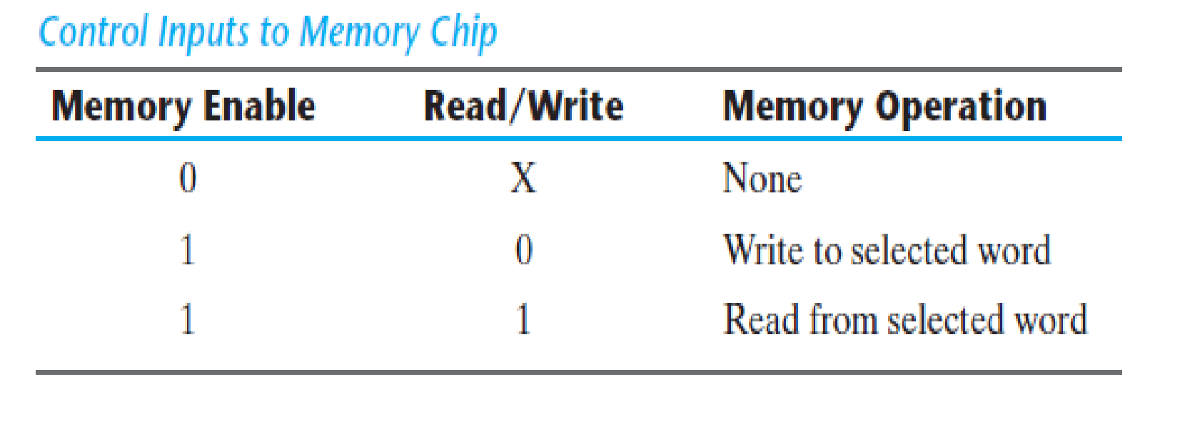
Write and Read operation
Two control inputs
Separate Read and Write input
Memory enable chip select + Read/Write operation select.

Slide 10
Timing waveform for memory
Memory operation controlled by external device such as CPU
CPU provides memory control signals to synchronize its internal clocked operation with memory operations.
CPU provides address to the memory.
Memory operation time
Access time: Time to select a word and Read it.
Cycle time: Time to complete a Write operation.

Slide 11
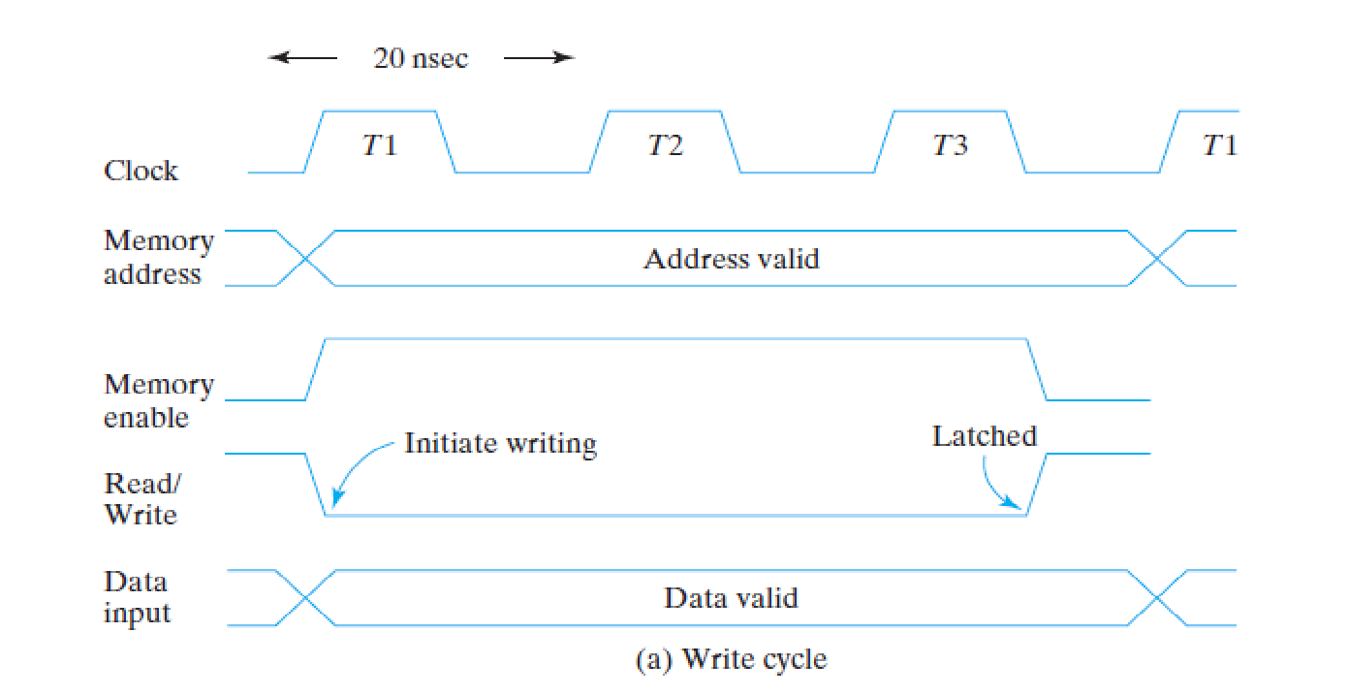
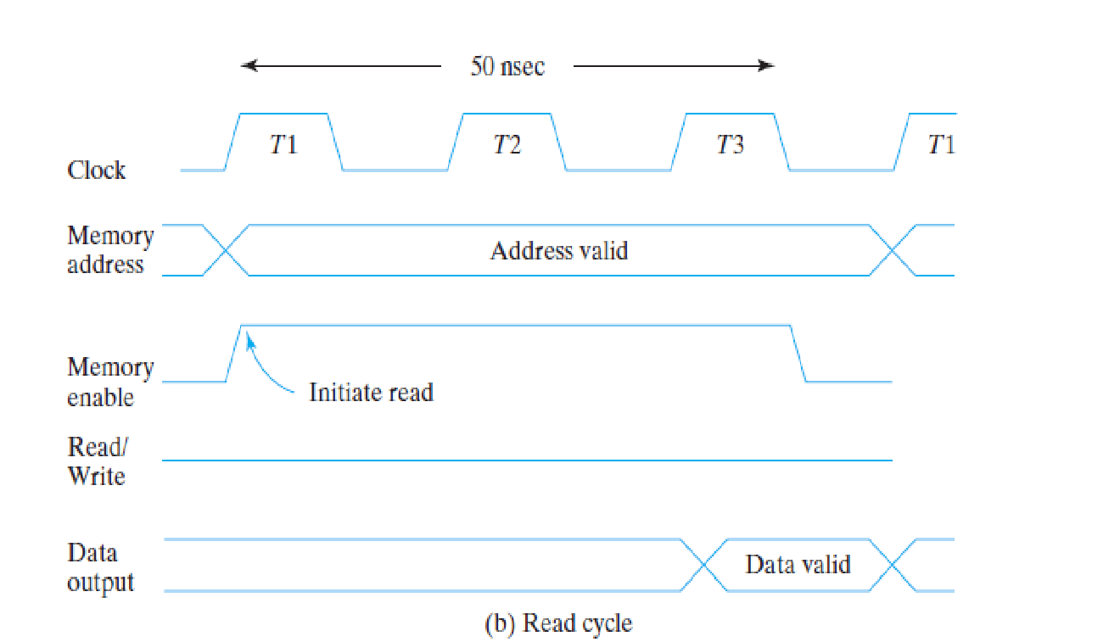
Cont
50Mhz CPU 1 clock cycle -20ns
Memory enable read write signal must be activated after the signals in the address lines are stable to avoid destroying of data.

Slide 12
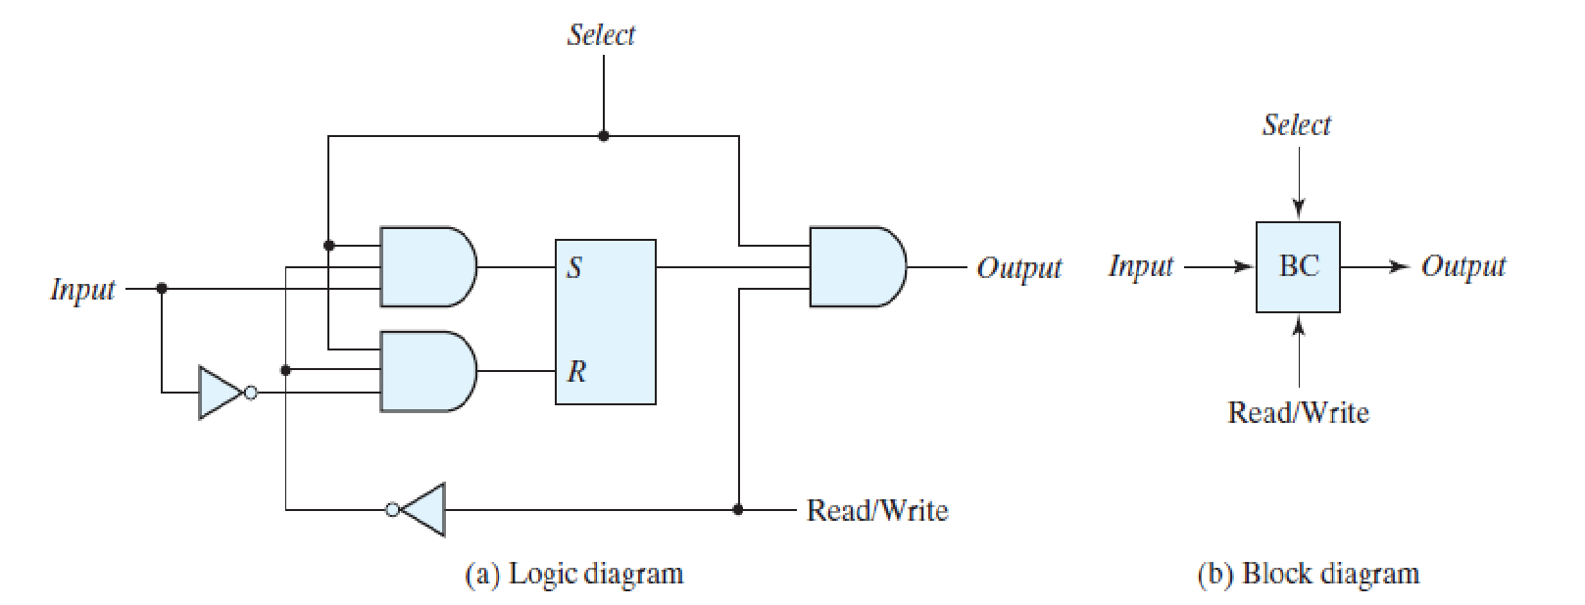
Memory decoding
RAM of m words and n bits m*n binary storage cells.
SRAM stores one bit in its internal latch
S-R Latch associated with 4 transistors.

Slide 13
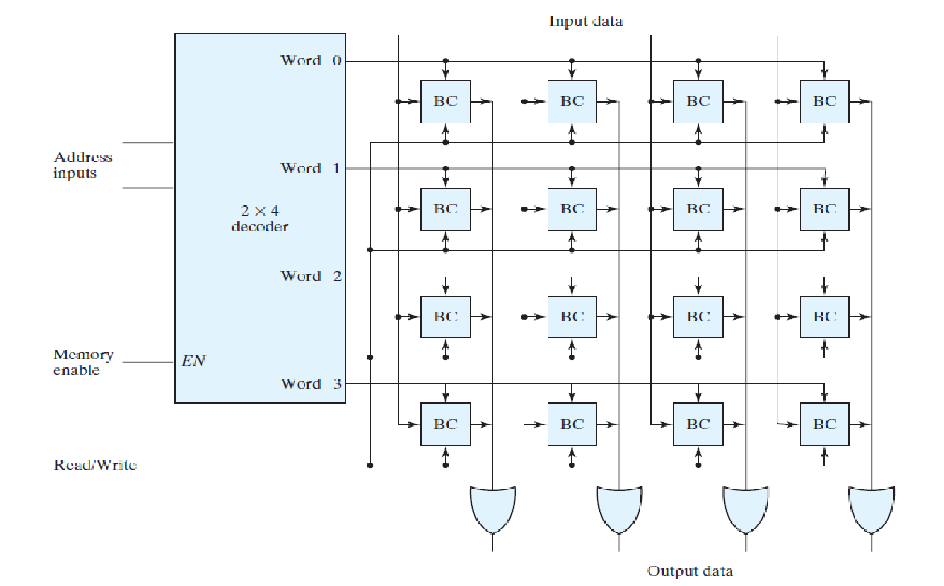
Capacity of 16 bits in 4 words of 4 bits each

Slide 14
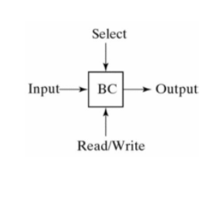
Capacity of 16 bits in 4 words of 4 bits
2x4 decoder: Select one of the 4 words enabled with the memory enabled signal.
Memory with 2 ^{K} words of n bits:
For K address lines Kx 2 ^{K} decoder.

Slide 15
Address multiplexing
DRAM: Large capacity requires large address decoding.
- Simple cell structure.
DRAM: A MOS transistor and a capacitor per cell.
SRAM: 6 transistors.
- Higher density four times the density of DRAM
Large capacity
Low power requirement.
64K = 2 ¹⁶ bits 256M= 2 ²⁸ bits
Needs 16 and 28 address input.

Slide 16
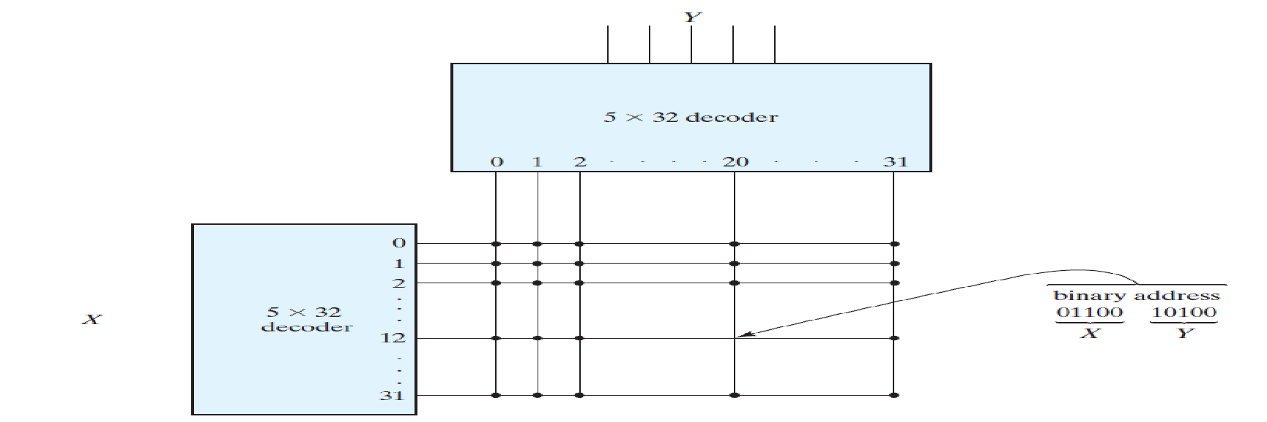
Address multiplexing
Address Multiplexing: Use a small set of address input pins to accommodate address component.
A full address is applied in multiple parts at different time.
Two dimensional array row address first and column address second.
Same set of pins are used for both parts.
Advantage: Reducing the number of pins for larger memory.

